Slide 1
IDEAS TO REALITY

Slide 2
PRODUCT DEVELOPMENT
TOPICS
Three key activities involved
How they interact with each other
Example

Slide 3
WHAT IS A PRODUCT ?
“A manufactured good that most closely meets the requirements of a particular market and yields enough profit to justify its continued existence.”
In short, an IDEA that has been converted to a profitable Reality
IDEAS TO REALITY

Slide 4
THREE VITAL AREAS
TECHNOLOGY
Starts with an Idea
Processes through design & engineering
MARKET
Needs to start at the beginning
Needs be ongoing
MANUFACTURING
Starts later
Vital to profits
BUT
THEY DO NOT WORK IN ISOLATION!

Slide 5
RESEARCH & DEVELOPMENT

Slide 6
MARKET

Slide 7
IMPORTANT INTERFACE
Before the design activity starts a Product Requirements Document must be prepared. This then leads to a Design Specification, which describes the technology, its application to meet the Product Requirements, manufacturing needs and cost/volume targets.

Slide 8
BUILDING THE PRODUCT

Slide 9
FIRST PRODUCTION RUN
Before the product is released to full production, the design team and the factory have to work together to refine the final design to optimize for manufacturability and to pass product/technology knowledge to the factory personnel.

Slide 10
DELIVERING THE PRODCUT TO THE CUSTOMER
Manufacturing and Marketing work with the distribution channels to optimize inventory and deliver the product to the customers.

Slide 11
PUTTING IT ALL TOGETHER

Slide 12
THE THING THAT MAKES IT ALL WORK $$$$

Slide 13
EXAMPLE
Mifarm.ag Management Inc.
Started 2 years ago after a year of research
$800K R&D expenses to date
A large public agribusiness invested initial $400K
First installation 1 year later
Product launch at Farmtech conference in January
$500k invested by farmers
$750k assistance from Agriculture and Agri-Food Canada

Slide 14
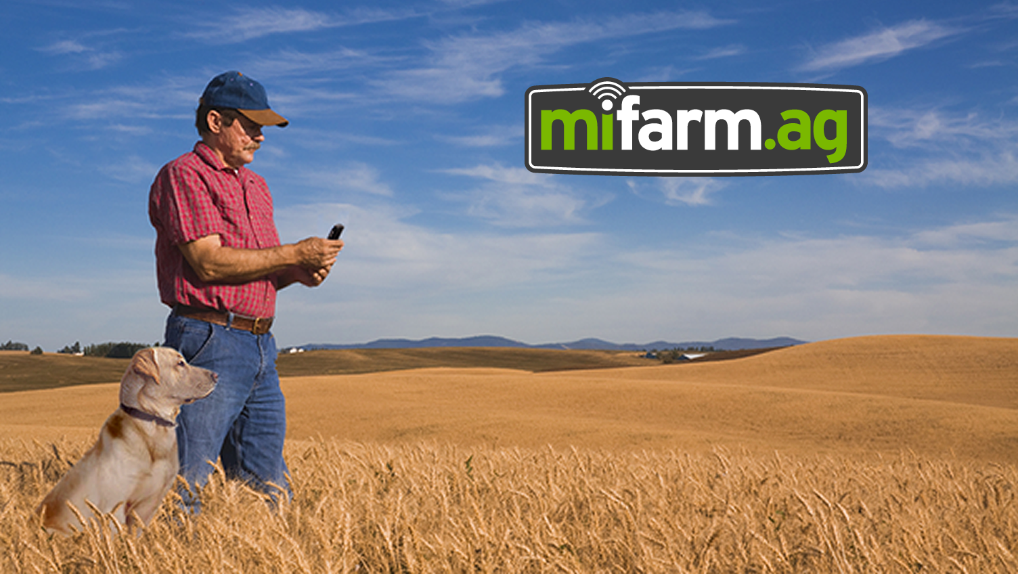
your farm
at your fingertips

Slide 15
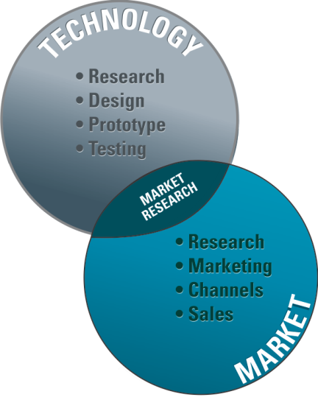
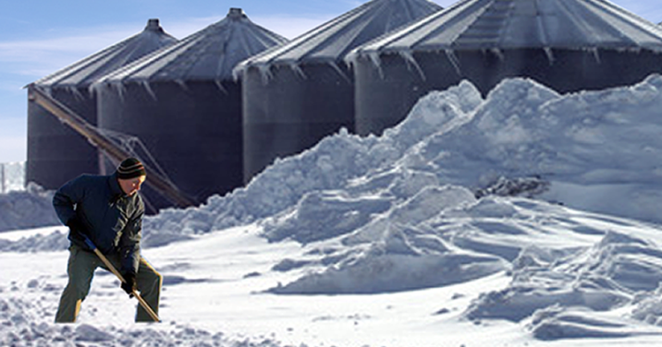
PRODUCT DEVELOPMENT
There is a need for farms to monitor various aspects of stored grain (mainly temperature).
An existing product allows the farmer to plug in a handheld instrument and view the temperature profile in a grain bin.
The problem is this just does not get done often enough to be effective.
PROBLEM
SOLUTION

Slide 16
TECHNOLOGY
ON-FARM STORED GRAIN NEEDS TO BE MONITORED
Damp grain reduces the value and can rot
Insect activity impacts stored grain
Quantity
Grade
THE NEED
Sensors developed
Low cost temperature sensors
Support cable
Level sensor
Humidity sensor
CO2 sensor
Fan controller
Weather station
Automatic Alarms
THE TECHNICAL SOLUTION
ALL WEB BASED

Slide 17
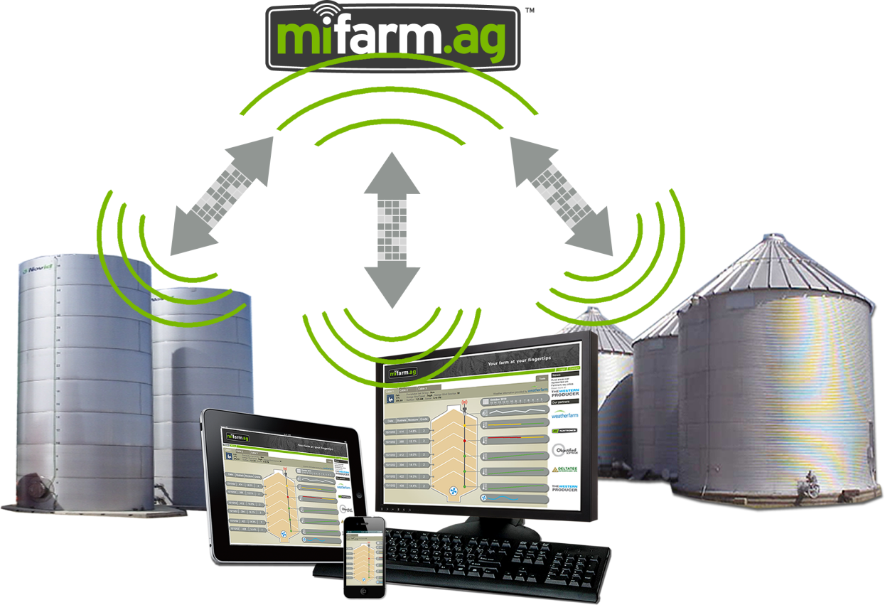
TECHNOLOGY
Solar power
Local RF network
Cellular link
Historical data base
Web interface
Automatic alarms
Fan control
Variety of sensors

Slide 18
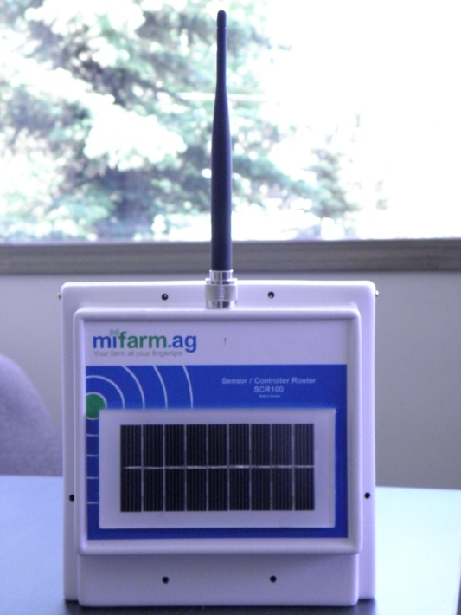
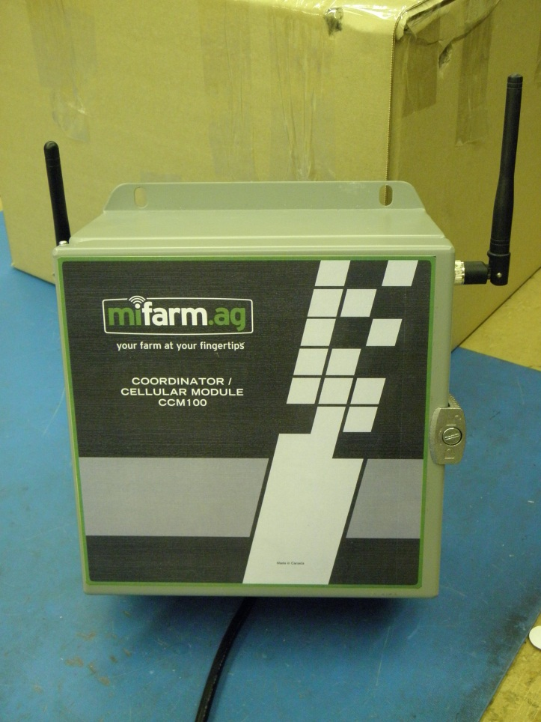
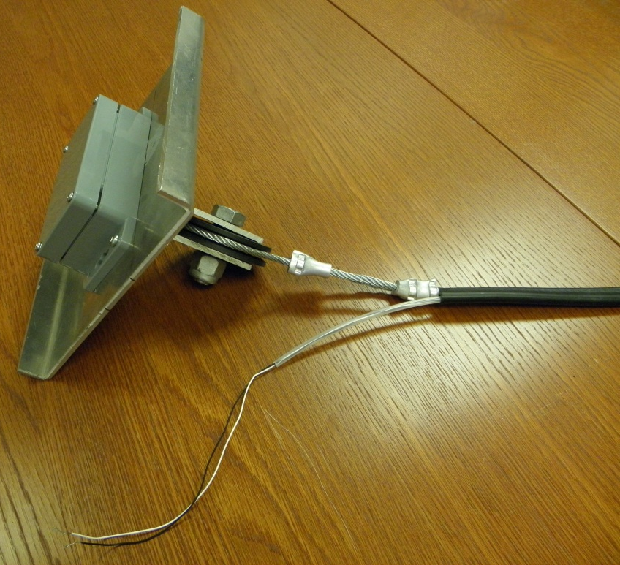
FIRST PRODUCTION
Router
Coordinator
Sensor Cable

Slide 19
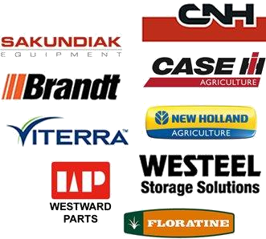
WORK IN PROGRESS
Third round financing being negotiated
Distribution discussions underway
Training manuals prepared

Slide 20
$ $ $
R&D costs assisted by NRC-IRAP & SRED
Minimize initial Overhead
Best money comes from the industry
Raised in stages
Agriculture and Agri-Food Canada long term loan
Bank and leasing financing

Slide 21
WHAT IS NEXT ?
First product run of 300 cables being installed
Start production run of 3000 cables spring/summer 2013 installation
Partner with large Agribusiness
Exit

Slide 22
IDEAS TO REALITY
DELTATEE.COM

